Slide 1


SCIENTIFIC CALCULATOR
A Mini Project Report Submitted
In Partial Fulfillment of the Requirement For the Degree of
BACHELOR OF TECHNOLOGY
In
COMPUTER SCIENCE & ENGINEERING
By
NAME – FAIZ MOHAMMAD (200056010045)
Under the Supervision of
GUIDE NAME - SAMEER AWASTHI (FACULTY-CSE)
DEPARTMENT OF COMPUTER SCIENCE & ENGINEERING
BABU BANARASI DAS NORTHERN INDIA INSTITUTE OF TECHNOLOGY, LUCKNOW
Affiated to
Dr. A.P.J ABDUL KALAM TECHNICAL UNIVERSITY LUCKNOW
(Formerly Uttar Pradesh Technical University,Lucknow) Jan,2022

Slide 2
DECLARATION
We hereby declare that the work presented in this report entitled “DIGITAL DISPLAY”, was carried out by us. We have not submitted the matter embodied in this report for the award of any other degree or diploma of any other University or Institute.
We have given due credit to the original authors/sources for all the words, ideas, diagrams, graphics, computer programs, experiments, results, that are not our original contribution. We have used quotation marks to identify verbatim sentences and given credit to the original authors/sources.
We affirm that no portion of our work is plagiarized, and the experiments and results reported in the report are not manipulated. In the event of a complaint of plagiarism and the manipulation of the experiments and results, we will be fully responsible and answerable.
Name Student :FAIZ MOHAMMAD Enroll. No. :2000560100045
(Candidate Signature)

Slide 3
CERTIFICATE
Certified that Mohd. Amaan khan (2000560100068) have carried out the Project work presented in this report entitled “Scientific calculator” for the award of Bachelor of Technology from Dr. APJ Abdul Kalam Technical University, Lucknow under my supervision. The thesis embodies results of original work, and studies are carried out by the student himself and the contents of the report do not form the basis for the award of any other degree to the candidate or to anybody else from this or any other University/Institution.
Signature
Signature
(Name of Supervisor)
Dr. Anurag Shrivastava
(Designation)
Professor & Head
Computer Science & Engineering BBDNIIT, Lucknow
(Address)
Date:

Slide 4
ACKNOWLEDGEMENT
We want to express deepest gratitude to everyone who has helped us in
completing this study successfully.First, we express the gratitude to our project supervisor prof. Sameer Awasthi
deepest for the
unwavering support, guidance & important contributions by the way of suggestions for improvement during our project work.
We are very much thankful to Head of Department, Prof. Anurag Shrivastava who understood the complications which we faced during the project and gave us the freedom to proceed as required.
We are also thankful to the faculty members and staff of Computer Science and Engineering Department of BBDNIIT, Lucknow who have consistently supported us by pointing out the various shortcomings that they felt plagued the project at various points of time and helped us directly or indirectly while completing the project.
Last but not the least there is a deepest gratitude towards our parents and friends whose support and blessing help us to complete the project successfully.
FAIZ MOHAMMAD
(2000560100068)

Slide 5
TABLE OF CONTENTS
Page No.
i
Declaration
Certificate
ii
Abstract
iii
Acknowledgement
iv
List of Tables
v
List of Figures
vi
List of Symbols and Abbreviations
vii
Introduction System
Requirements
Future Scope
Conclusions References

Slide 6
CHAPTER 1
1. INTRODUCTION C:
WHAT IS C ?
. C is a general-purpose high level language.
. The C programming language is a computer programming language that was developed to do system programming for the operating system UNIX and is an imperative programming language.
WHY C?
. C is a general-purpose programming language and can efficiently work on enterprise applications, games, graphics, and applications requiring calculations, etc.
. C language has a rich library which provides a number of built-in functions.
. C language has a rich library which provides a number of built-in functions.
. It also offers dynamic memory allocation.
. C is highly portable language i.e. code written in one machine can be moved to other which is very important and powerful feature.
. C supports low level features like bit level programming and direct access to
memory using pointer which is very useful for managing resource efficiently.

Slide 7
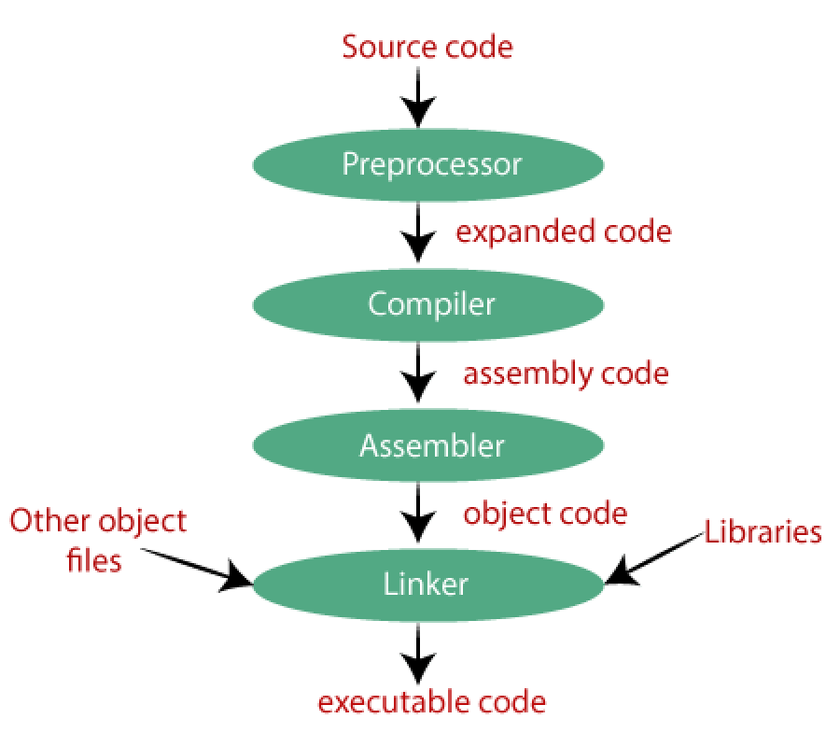
. Why not c?
. C is a Procedural Oriented language, whereas C++ is an Object-Oriented Programming language.
.C supports only Pointers whereas C++ supports both pointers and references.
. C does not allow you to use function overloading whereas C++ allows you to use function overloading.
. How Does C Work ?

Slide 8
History:
C History and Versions
. The C programming language came out of Bell Labs in the early
1970s.
. According to the Bell Labs paper The Development of the C Language by Dennis Ritchie.
. The C programming language was devised in the early 1970s as a system implementation language for the nascent Unix operating system.
. Derived from the typeless language BCPL, it evolved a type structure; created on a tiny machine as a tool to improve a meager programming environment.
. The development of C was to become the basis for Unix.
. In 1978, Brian Kernighan and Dennis Ritchie published The C Programming Language.
C Version List
VERSION | STANDARD | PUBLICATION DATE
K&R | n/a | 1978-02-22
C89 | ANSI X3.159-1989 | 1989-12-14
C90 | ISO/IEC 9899:1990 | 1990-12-20
C95 | ISO/IEC 9899/AMD1:1995 | 1995-03-30
C99 | ISO/IEC 9899:1999 | 1999-12-16
C11 | ISO/IEC 9899:2011 | 2011-12-15

Slide 9
CHAPTER:- 2
INTRODUCTION OF SCIENTIFIC CALCULATOR
A scientific calculator is a
calculator designed to help you calculate science, engineering, and mathematics problems. It has special buttons for parentheses, trigonometric functions, exponents, inverses of trigonometric
functions, and π. Every scientific calculator follows different rules. A calculator is a device that performs arithmetic operations on numbers. The simplest calculators can do only addition, subtraction, multiplication, and division.
More sophisticated calculators can handle exponent ial operations, roots, logarithm s, trigonometric functions, and hyperbolic functions. Calculators allow the students access to mathematical concepts and experiences from which they were

Slide 10
CHAPTER: 3
OBJECTIVE
A digital calculator is a type of electronic calculator, usually but not always handheld, designed to calculate problems in science, engineering, and mathematics. They have completely replaced slide rules in traditional applications, and are widely used in both education and professional settings.
Calculators can save a whole lot of computational time
Using a calculator in classes can help students save a whole lot of computational time on basic arithmetical calculations. This makes it easier for them to stress more on important math concepts rather than stressing more on basic arithmetical calculations

Slide 11
CHAPTER:-4
CODING:-
#include<stdio.h> #include<conio.h> #include<math.h> #define PI 3.141
#define MAX 180 #include<stdlib.h> #include<string.h> int x=0,result=0; void add(void); void sub(void); void mul(void); void div(void); void clear(void); void sine(void); void cosine(void); void sec(void); void cosec(void); void tangent(void);
void cotangent(void);
void cube(void); void square(void); void sqroot(void); void mod(void); int menu(void); void main()

Slide 12
{
char name[20],password[20];
int r;
clrscr();
printf("enter the name of canditate:"); gets(name);
printf("enter the password:"); gets(password); r=strcmp(name,password); getch();
while(1)
{
clrscr(); textcolor(BLUE);
cprintf("\n\nresult : %d\n",result); scanf("%d",&result);
getch();
switch(menu())
{
case 1: add(); x=1;
break; case 2: sub(); x=1;
break; case 3: mul(); x=1;
break; case 4:
div();
x=1;
break;

Slide 13
case 5:
mod();
x=1;
break; case 6:
clear(); x=0;
break; case 7:
sine();
break; case 8:
cosine(); break;
case 9:
tangent();
break;
case 10:
cotangent(); break;
case 11:
sec(); break;
case 12:
cosec();
break; case 14:
cube(); break;
case 15:
square(); break;
case 16:
sqroot(); break;

Slide 14
case 13:
exit(0);
default:
printf("WRONG CHOICE : break;
}
getch();
} }
int menu(void)
{
SELECT AGAIN: \n");
int m;
printf("\n# # # # # # # # # # # # # # # # # # # ");
printf("\n# 1 | add | # ");
printf("\n# 2 | sub | # ");
printf("\n# 3 | mul | # ");
printf("\n# 4 | div | # ");
printf("\n# 5 | mod | # ");
printf("\n# 6 | clear | # ");
printf("\n# 7 | sin | # ");
printf("\n# 8 | cos | # ");
printf("\n# 9 | tan | # ");
printf("\n# 10 | cot | # ");
printf("\n# 11 | sec | # ");
printf("\n# 12 | cosec | # ");
printf("\n# 13 | exit | # ");
printf("\n# 14 | *** | # ");
printf("\n# 15 | ** | # ");
printf("\n# 16 | sqrt | # ");
printf("\n# # # # # # # # # # # # # # # # # # # ");
printf("\n\nenter a option: "); scanf("%d",&m);
return m;
}

Slide 15
void add()
{
int a,b;
if(x)
{ textcolor(GREEN); cprintf("enter a number : "); scanf("%d",&a); result=result+a; printf("result =%d",result);
}
else
{ textcolor(GREEN); printf("enter two number: "); scanf("%d%d",&a,&b); result=a+b;
cprintf("result = %d",result);
}
}
void sub()
{
int a,b;
if(x)
{textcolor(GREEN); printf("enter a number: "); scanf("%d",&a); result=result-a;
cprintf("result = %d",result);
}
else
{textcolor(GREEN); printf("enter two number: "); scanf("%d%d",&a,&b); result=a-b;
cprintf("result =%d",result);
}
}

Slide 16
void mul()
{
int a,b;
if(x)
{textcolor(GREEN); printf("enter a number: "); scanf("%d",&a); result=result*a;
cprintf("result
}
else
=%d",result);
{textcolor(GREEN);
printf ("enter two number : "); scanf("%d%d",&a,&b); result=a*b;
cprintf("result = %d",result);
}
}
void div()
{
float a,b,finalresult; if(x)
{ textcolor(GREEN); printf("enter a number: "); scanf("%f",&a); result=result/a; cprintf("result =%d",result);
}
else
{ textcolor(GREEN); printf("enter two number: "); scanf("%f%f",&a,&b); result=a/b;
cprintf("result = %f",result);
}
}

Slide 17
void mod()
{
int a,b; if(x)
{ textcolor(GREEN); printf("enter a number : "); scanf("%d",&a); result=result%a;
cprintf("result =
}
else
%d",result);
{textcolor(GREEN); printf("enter two number: "); scanf("%d%d",&a,&b); result=a%b;
cprintf("result = %d",result);
}
}
void clear()
{
printf("DATA IS CLEARED: \n");
result=0; x=0;
}
void sine()
{
textcolor(RED); int angle;
float m,n;
cprintf("enter the angle: "); scanf("%d",&angle);
n=(PI/MAX)*angle;
m=sin(n); cprintf("value: %f",m);
}

Slide 18
void cosine()
{textcolor(RED);
int angle;
float m,n;
cprintf("enter the angle: "); scanf("%d",&angle); n=(PI/MAX)*angle; m=cos(n);
cprintf("value : %f",m);
}
void tangent()
{textcolor(RED); int angle;
float m,n;
cprintf("enter the angle: "); scanf("%d",&angle); n=(PI/MAX)*angle; m=tan(n);
cprintf("value : %f ",m);
}
void cotangent()
{textcolor(RED); int angle;
float m,n;
cprintf("enter the angle: ");
scanf("%d",&angle); n=(PI/MAX)*angle; m=1/tan(n); cprintf("value : %f",m);
}

Slide 19
void sec()
{textcolor(RED); int angle;
float m,n;
cprintf("enter the angle: "); scanf("%d",&angle);
n=(PI/MAX)*angle; m=1/cos(n); cprintf("value : %f",m);
}
void cosec()
{ textcolor(RED); int angle;
float m,n;
cprintf("enter the angle: ");
scanf("%d",&angle); n=(PI/MAX)*angle; m=1/sin(n); cprintf("value : %f",m);
}
void cube()
{ textcolor(RED); int m,n;
printf("enter the number:");
scanf("%d",&n); m=n*n*n; cprintf("result=%d",m);
}

Slide 20
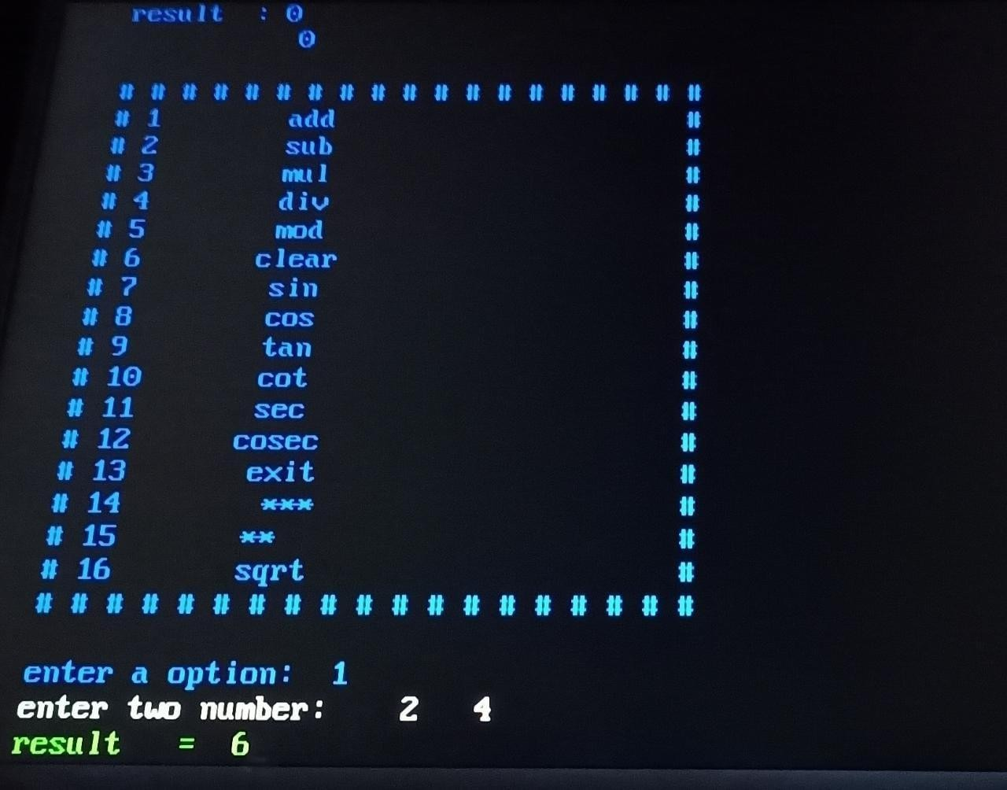
void square()
{ textcolor(RED);
int m,n;
printf("enter the number:"); scanf("%d",&n);
m=n*n; cprintf("result=%d",m);
}
void sqroot()
{textcolor(RED);
int m,n;
printf("enter the number:"); scanf("%d",&n); m=sqrt(n); cprintf("result=%d",m);
}

Slide 21
CONCLUSION
In the end , I would like to concluded that my aim to make this Project was to research in the field of C Programming.
some scope of improvement also there .
REFERENCES
. C: The Complete Reference
The Complete Reference 4th Edition is Herbert Schildt is an ideal C++ reference. It teaches C as a subset of C++.
. Head First C: A Brain-Friendly
Guide
Head First C written by Griffiths David provides you in-depth knowledge about the C language.
. Expert C Programming: Deep
Secrets
Expert C programming is a book written by Peter Van Der Linden is a second book which offers many advanced tips

